Slide 1
TIME EFFICIENT DISTRIBUTED FILE STORAGE AND SHARING USING P2P NETWORKS

Slide 2
Objective
TIME EFFICIENT DISTRIBUTED FILE STORAGE AND SHARING USING P2P NETWORKS is a concept of public or private sharing of computer data or space in a network with various levels of access privileges. While files can easily be shared outside a network (for example, simply by handling or mailing someone your file), the term TIME EFFICIENT DISTRIBUTED FILE STORAGE AND SHARING USING P2P NETWORKS almost always means sharing files in a network, even if in a small local area network. TIME EFFICIENT DISTRIBUTED FILE STORAGE AND SHARING USING P2P NETWORKS allows a number of people to use the same file. TIME EFFICIENT DISTRIBUTED FILE STORAGE AND SHARING USING P2P NETWORKS can also mean having an allocated amount of personal file storage in a common file system. It enables to create a central repository for organizing our folders. Within these folders we can create our own folders and we can upload our files into it. TIME EFFICIENT DISTRIBUTED FILE STORAGE AND SHARING USING P2P NETWORKS System provides a file management with secure access control, sharing and supporting File with in the registered users.

Slide 3
Existing System:
it is a manual System
total work is done by normal folders or files
may be chance loss data
dosn’t have security
dosn’t have distributing
there is no online storing facility
Increase the Human workload to search

Slide 4
Proposed System:
it is a Computerized process
so total work is done by computers
no data loss
it have security
it have sharing data
Here we have a online storing facility
Heavily reduces the human workload to search

Slide 5
Modules:
Authentication and Security Module
Users Module
File Management Module
Admin Module
Reports Module

Slide 6
MODULES DESCRIPTION Authentication and Security Module
The user details should be verified against the details in the user tables and if it is valid user, they should be entered into the system. Once entered, based on the user type access to the different modules to be enabled / disabled.

Slide 7
User Module
This module consists of the following sub modules
Registration Module
The general users who can use the application their personal
information, contact information and other information etc…
Users Management Module
The Users can access their account information and they can
view the details of their personal information and contact
details. The Users can modify the personal and contact details
of their in this module

Slide 8
File Management Module
This module has following sub modules
Folders Management Module:
In this module folder creation and maintenance, sub folder creation, deletion and
Managing the folder, the uploaded file can transfer from one folder to other
folders.
File Upload Management Module:
The file uploading and managing the file will come in this module. The files
accessibility privileges, information about the files size, type of the files, name of
the files and memory management for file uploading and file deletion etc.
File Download Management Module
In this module the file downloads and storing it in to their system. The
downloaded file information stores in the database. The files accessibility privilege
and information of the accessibility given users details, information about the files
size, type of the files, name of the files etc.

Slide 9
Admin Module
The Administrator is a main part of an organization that he may organize all the Users and their folders information. This administrator plays the main role in this system, here we are considering he should maintain all Users profile
details(address, contact, etc,….),on the user request to modify his/her (user) profile like address, phone number etc. He can also view the entire Users list.
The Administrator will maintain entire Users account history, folders history file history, and the Administrator can generate the reports like number of Users registered on the date bases reports etc.

Slide 10
Reports Module:
In this Module the User and Administrator can generate the different types of Reports according to their access. The User can generate the Report like how many no of other Users downloaded the Uploaded File and User can view their details, etc.
The Administrator can generate the Report like at present how many users are logged In , Number of Users are using the application and date wise registration Reports, etc.

Slide 11
Software Requirements
Operating System : WindowsXP/Win-7/Win-8/Linux
User Interface : HTML, CSS
Client-side Scripting : JavaScript
Programming Language : Java
Web Applications : JDBC, JNDI, Servlets,JSP
IDE/Workbench : My Eclipse
Database : Oracle10g
Server Deployment : Tomcat

Slide 12
Hardware Requirements
Processor : Core 2Duo/intel i3/i5/i7
Hard Disk : 40GB
RAM : 512mb/1 GB

Slide 13
SYSTEM REQUIREMENT SPECIFICATION

Slide 14
The Small world of distributed File Sharing System aims at providing and receiving of digital files over a network allowing multiple users to access the same file on priority level basis among the available users of the system.
Application For File Sharing System is a concept of public or private sharing of computer data or space in a network with various levels of access privileges. While files can easily be shared outside a network (for example, simply by handling or mailing someone your file), the term Application For File Sharing System almost always means sharing files in a network, even if in a small local area network. Application For File Sharing System allows a number of people to use the same file Application For File Sharing System can also mean having an allocated amount of personal file storage in a common file system. It enables to create a central repository for organizing our folders. Within these folders we can create our own folders and we can upload our files into it. Application For File Sharing System System provides a file management with secure access control, sharing and supporting File with in the registered users.

Slide 15
STUDY OF THE SYSTEM
In the flexibility of uses the interface has been developed a graphics concepts in mind, associated through a browser interface. The GUI’s at the top level has been categorized as follows
Administrator Interface Design.
User Interface.
Security Authentication.
Reports.
General end-users.

Slide 16
FEASIBILITY STUDY

Slide 17
TECHNICAL FEASIBILITY:
Evaluating the technical feasibility is the trickiest part of a feasibility study. This is because, at this point in time, not too many detailed design of the system, making it difficult to access issues like performance, costs on (on account of the kind of technology to be deployed) etc. A number of issues have to be considered while doing a technical analysis.
Understand the different technologies involved in the proposed system
Find out whether the organization currently possesses the required technologies
Operational Feasibility:
Proposed project is beneficial only if it can be turned into information systems that will meet the organizations operating requirements. Simply stated, this test of feasibility asks if the system will work when it is developed and installed. Are there major barriers to Implementation? Here are questions that will help test the operational feasibility of a project:Is there sufficient support for the project from management from users? If the current system is well liked and used to the extent that persons will not be able to see reasons for change, there may be resistance.

Slide 18
Economic Feasibility:
Economic feasibility attempts 2 weigh the costs of developing and implementing a new system, against the benefits that would accrue from having the new system in place. This feasibility study gives the top management the economic justification for the new system.

Slide 19
DATA FLOW DIAGRAMS

Slide 20
A graphical tool used to describe and analyze the moment of data through a system manual or automated including the process, stores of data, and delays in the system. Data Flow Diagrams are the central tool and the basis from which other components are developed. The transformation of data from input to output, through processes, may be described logically and independently of the physical components associated with the system. The DFD is also know as a data flow graph or a bubble chart.
Dataflow: Data move in a specific direction from an origin to a destination.
Process: People, procedures, or devices that use or produce (Transform) Data. The physical component is not identified.
Source: External sources or destination of data, which may be People, programs, organizations or other entities.
Data Store: Here data are stored or referenced by a process in the System.

Slide 21
CONTEXT LEVEL DATA FLOW DIAGRAM

Slide 22
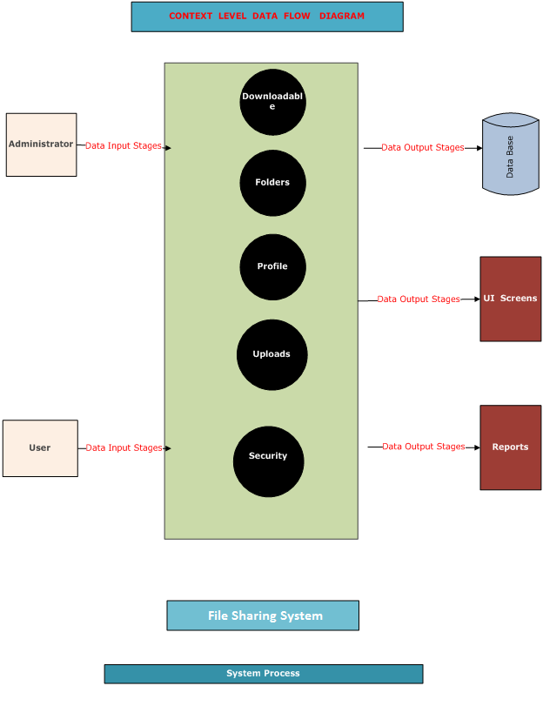
SYSTEM LEVEL CONTEXT DIAGRAM:

Slide 23
LEVEL-1 DFD

Slide 24
AUTHENTICATION DFD:

Slide 25
ADMINISTRATOR CONTEXT LEVEL DFD

Slide 26
Level 1.0:
Level 1.0.1:
Level 1.1:

Slide 27
Level 1.1.0:-
Level 1.2:-

Slide 28
USER CONTEXT LEVEL DFD

Slide 29
Level 1.0:-
Level 1.1:-
Level 1.2:-

Slide 30
Level 1.3:-
Level-1.0.1 Diagram:

Slide 31
SDLC METHODOLOGIES

Slide 32
This document play a vital role in the development of life cycle (SDLC) as it describes the complete requirement of the system. It means for use by developers and will be the basic during testing phase. Any changes made to the requirements in the future will have to go through formal change approval process.
SPIRAL MODEL was defined by Barry Boehm in his 1988 article, “A spiral Model of Software Development and Enhancement. This model was not the first model to discuss iterative development, but it was the first model to explain why the iteration models.
The steps for Spiral Model can be generalized as follows:
The new system requirements are defined in as much details as possible. This usually involves interviewing a number of users representing all the external or internal users and other aspects of the existing system.
A preliminary design is created for the new system.
A first prototype of the new system is constructed from the preliminary design. This is usually a scaled-down system, and represents an approximation of the characteristics of the final product.

Slide 33
A second prototype is evolved by a fourfold procedure:
Evaluating the first prototype in terms of its strengths, weakness, and risks.
Defining the requirements of the second prototype.
Planning an designing the second prototype.
Constructing and testing the second prototype.
Risk factors might involved development cost overruns, operating-cost miscalculation, or any other factor that could, in the customer’s judgment, result in a less-than-satisfactory final product.
The existing prototype is evaluated in the same manner as was the previous prototype, and if necessary, another prototype is developed from it according to the fourfold procedure outlined above.
The preceding steps are iterated until the customer is satisfied that the refined prototype represents the final product desired.
The final system is constructed, based on the refined prototype.
The final system is thoroughly evaluated and tested. Routine maintenance is carried on a continuing basis to prevent large scale failures and to minimize down time.

Slide 34
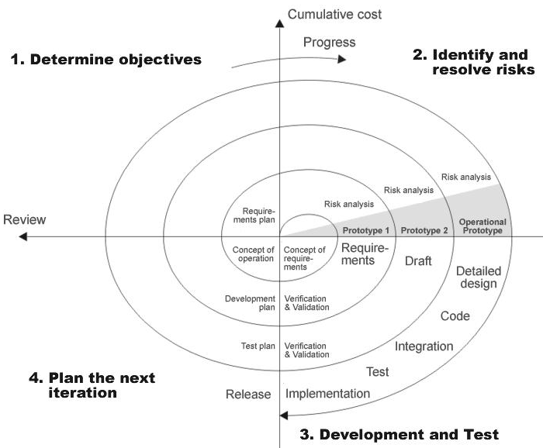
THE FOLLOWING DIAGRAM SHOWS HOW A SPIRAL MODEL ACTS LIKE:

Slide 35
ADVANTAGES OF SPIRAL MODEL:
Estimates(i.e. budget, schedule etc .) become more realistic as work progresses, because important issues discovered earlier.
It is more able to cope with the changes that are software development generally entails.
Software engineers can get their hands in and start working on the core of a project earlier.

Slide 36
E-R DIAGRAM

Slide 38
UML DIAGRAMS

Slide 39
UNIFIED MODELING LANGUAGE DIAGRAMS
The unified modeling language allows the software engineer to express an analysis model using the modeling notation that is governed by a set of syntactic semantic and pragmatic rules.
A UML system is represented using five different views that describe the system from distinctly different perspective. Each view is defined by a set of diagram, which is as follows.
USER MODEL VIEW
This view represents the system from the users perspective.
The analysis representation describes a usage scenario from the end-users perspective.
STRUCTURAL MODEL VIEW
In this model the data and functionality are arrived from inside the system.
This model view models the static structures.
BEHAVIORAL MODEL VIEW
It represents the dynamic of behavioral as parts of the system, depicting the interactions of collection between various structural elements described in the user model and structural model view.

Slide 40
IMPLEMENTATION MODEL VIEW
In this the structural and behavioral as parts of the system are represented as they are to be built.
ENVIRONMENTAL MODEL VIEW
In this the structural and behavioral aspects of the environment in which the system is to be implemented are represented.
UML is specifically constructed through two different domains they are:
UML Analysis modeling, which focuses on the user model and structural model views of the system.
UML design modeling, which focuses on the behavioral modeling, implementation modeling and environmental model views.
Use case Diagrams represent the functionality of the system from a user’s point of view. Use cases are used during requirements elicitation and analysis to represent the functionality of the system. Use cases focus on the behavior of the system from external point of view.
Actors are external entities that interact with the system. Examples of actors include users like administrator, bank customer …etc., or another system like central database.

Slide 41
CLASS DIAGRAM

Slide 42
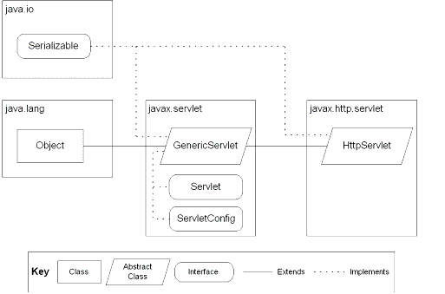
CLASS DIAGRAM
Class diagrams describe the structure of the system in terms of classes and objects. The servlet api class diagram will be as follows.
JSP: Implicit Objects

Slide 43
CLASS COLLABORATION DIAGRAMS

Slide 45
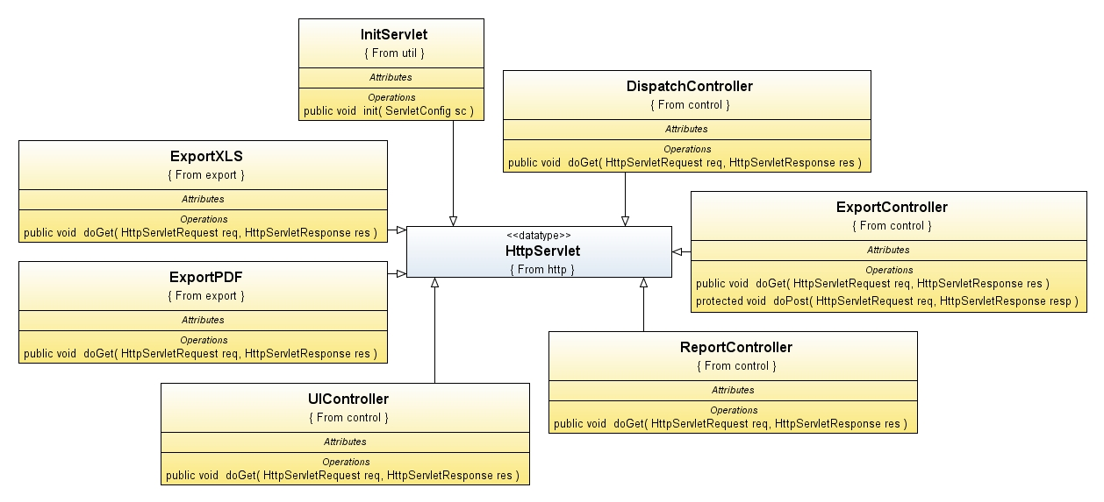

Slide 46
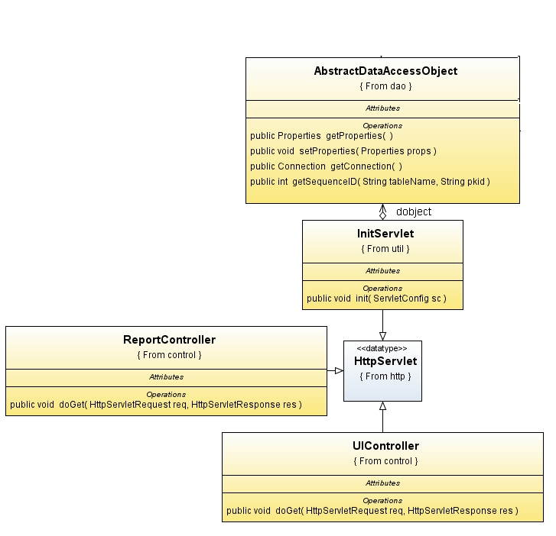

Slide 47
USE CASE DIAGRAMS

Slide 48
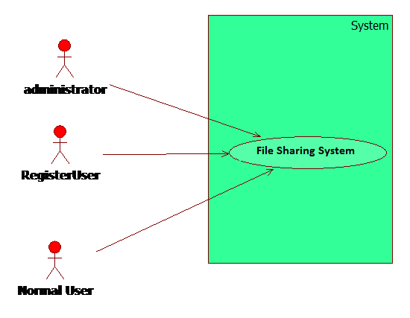
System Diagram:

Slide 49
2.Administrator:

Slide 50
3. RegisterUser:

Slide 52
4. Normal User

Slide 53
SEQUENCE DIAGRAMS

Slide 54
User

Slide 55
Administrator

Slide 56
OPERATIONAL LEVEL SEQUENCE DIAGRAMS

Slide 57
Login Sequence Diagram

Slide 58
Login Collaborative Diagram

Slide 59
2. Upload Sequence Diagram

Slide 60
Upload Collaborative Diagram

Slide 61
3. Download Sequence Diagram

Slide 62
Download Sequence Diagram

Slide 63
4. Present Login User Report Sequence Diagram

Slide 64
Present Login User Report Collaborative Diagram

Slide 65
ACTIVITY DIAGRAM

Slide 66
User/Administrator Activity Diagram:

Slide 67
Upload Activity Diagram:

Slide 68
Download Activity Diagram

Slide 69
COMPONENT DIAGRAM

Slide 70
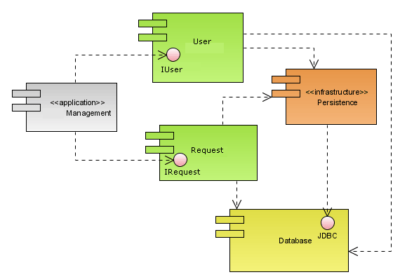
Component Diagram :

Slide 71
DEPLOYMENT DIAGRAM

Slide 72
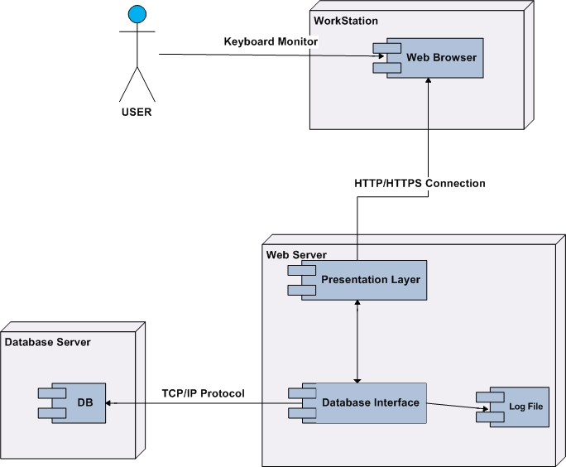

Slide 73
OUTPUT SCREENS

Slide 74
HOMEOUTPUT SCREENS

Slide 75
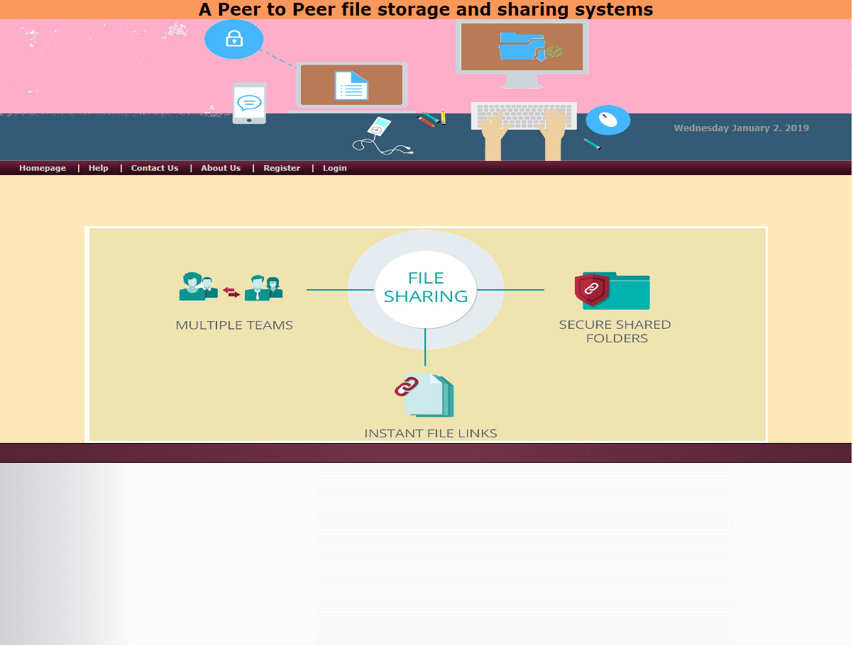

Slide 76
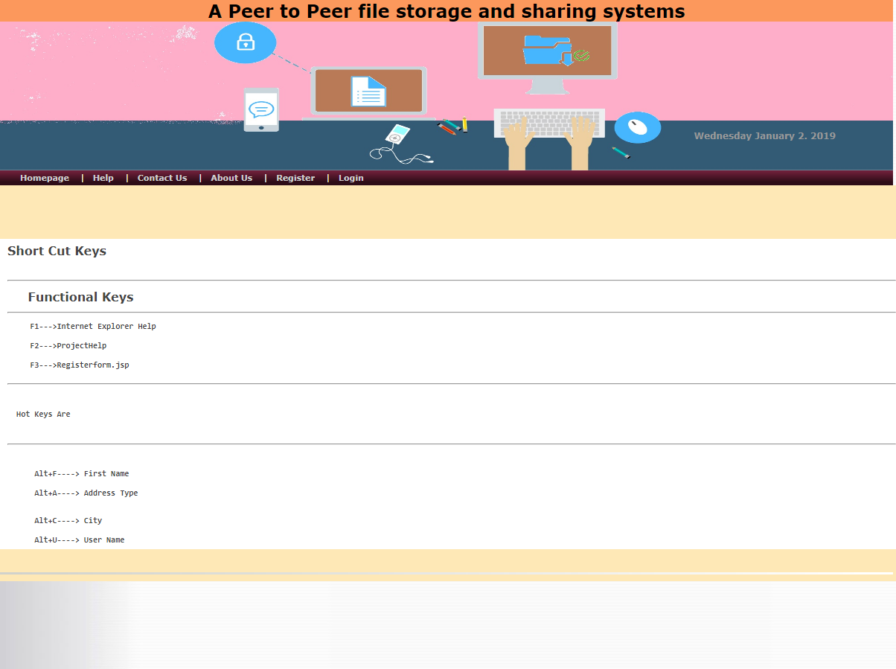

Slide 77
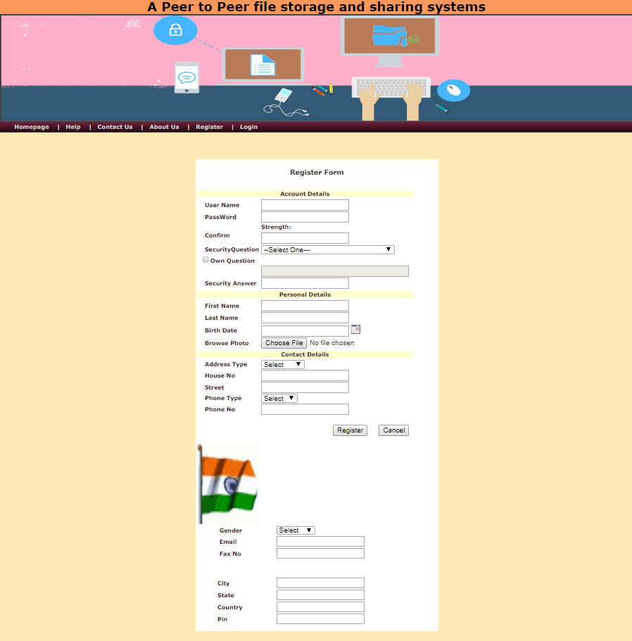

Slide 78
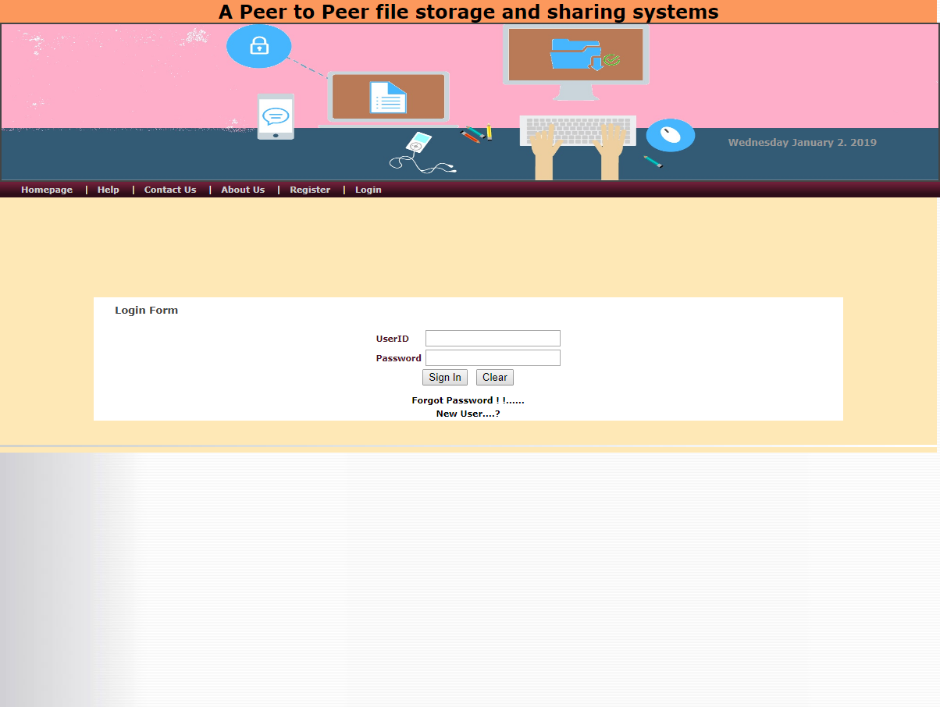

Slide 79
ADMINOUTPUT SCREENS

Slide 80
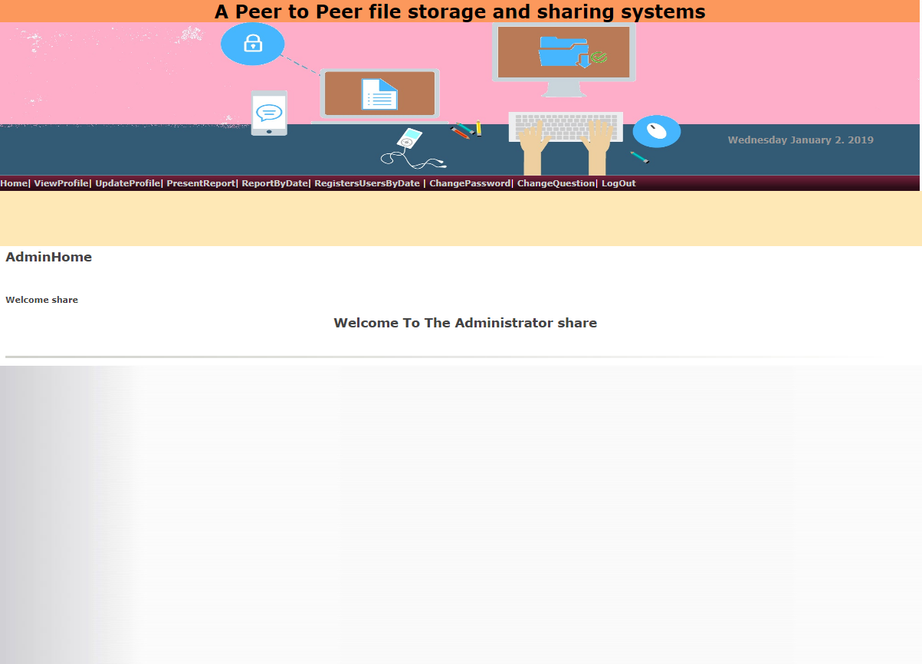

Slide 81
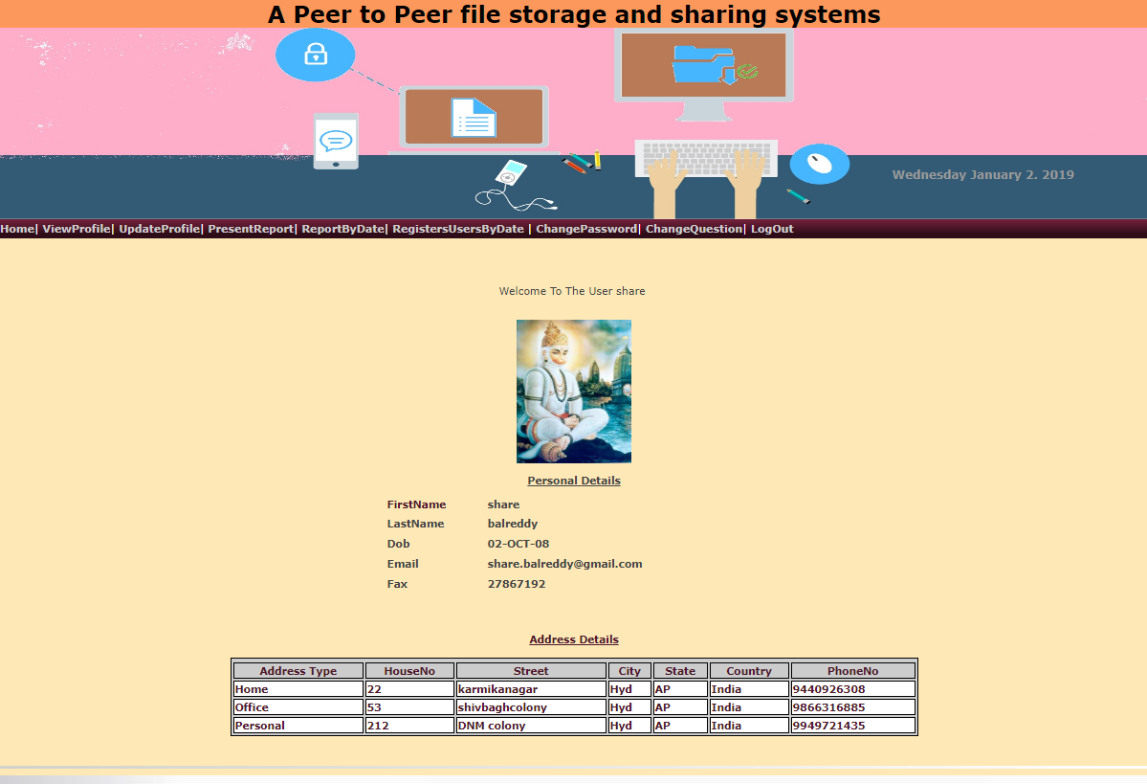

Slide 82
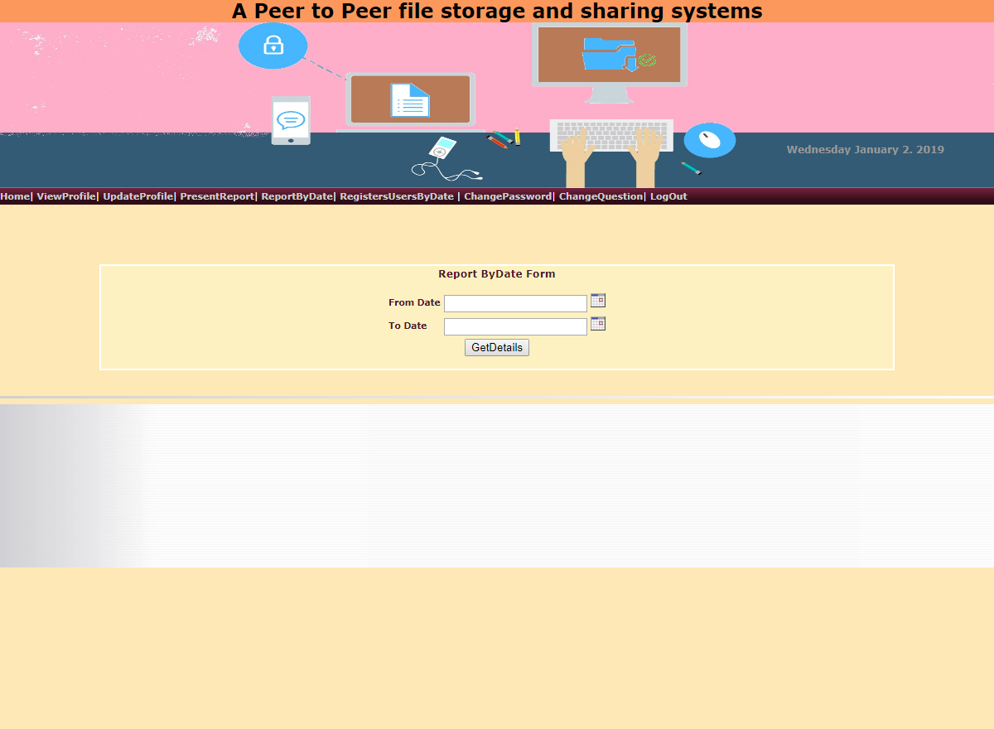

Slide 83
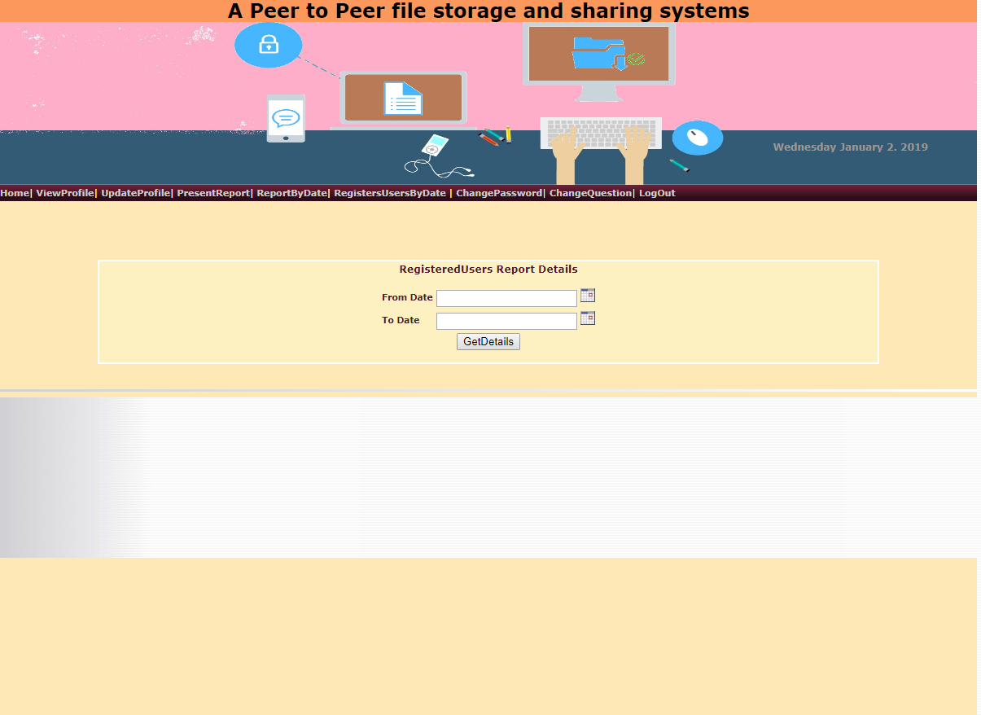

Slide 84
USER OUTPUT SCREENS

Slide 85
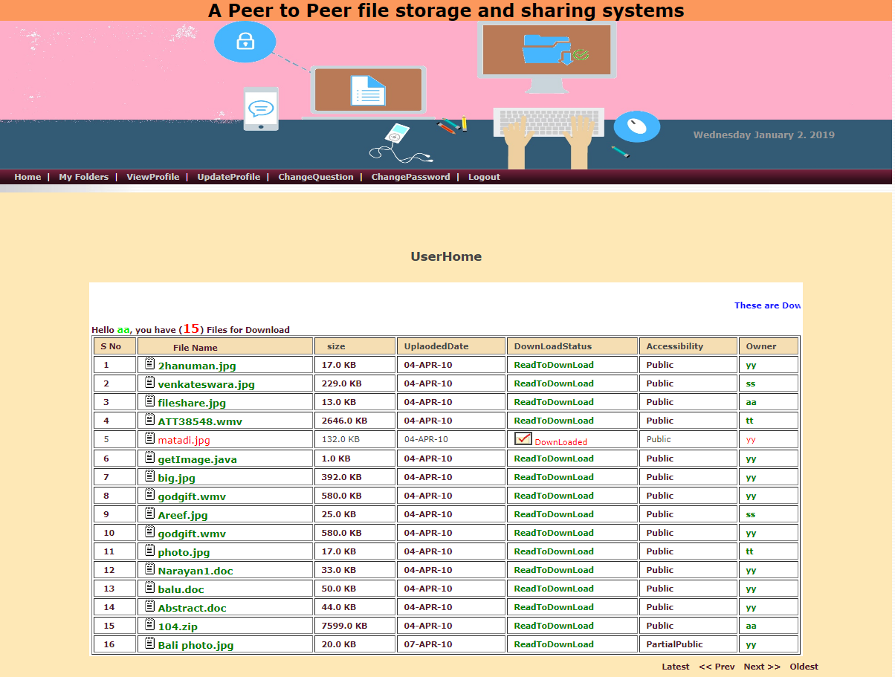

Slide 86
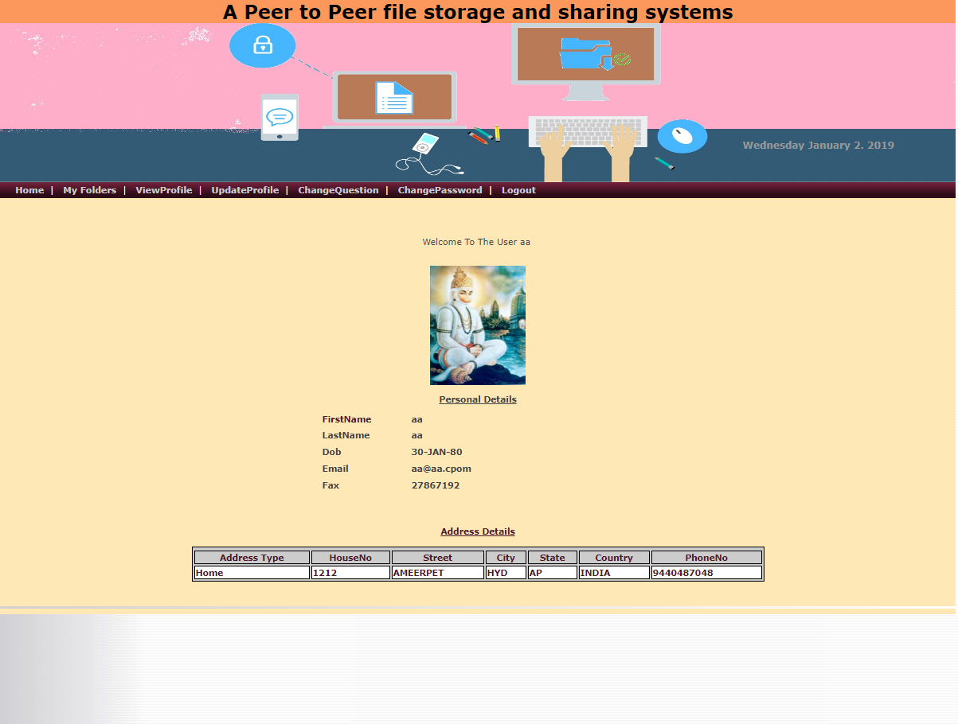

Slide 87
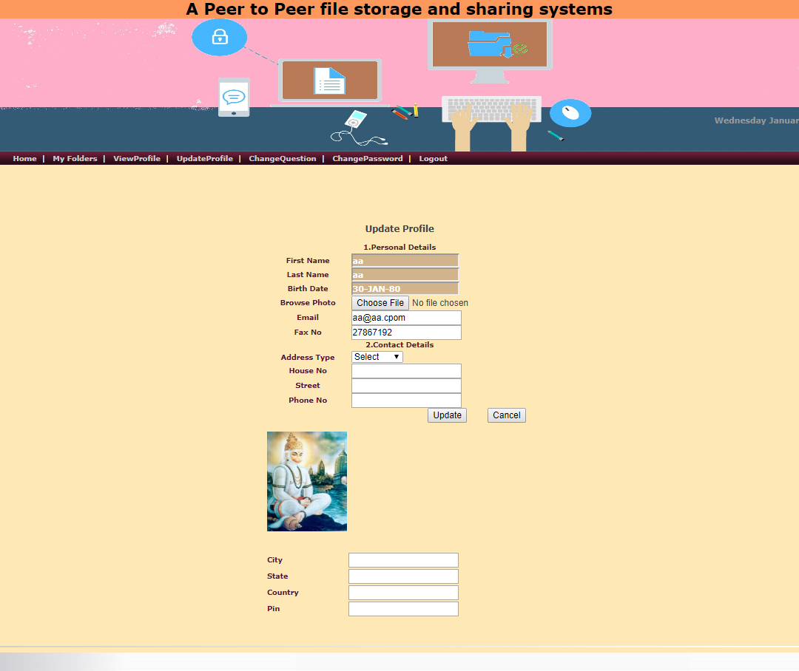

Slide 88
THANK YOU

